Slide 1
Lets Ball
Blacks In Technology
BITCON

Slide 2
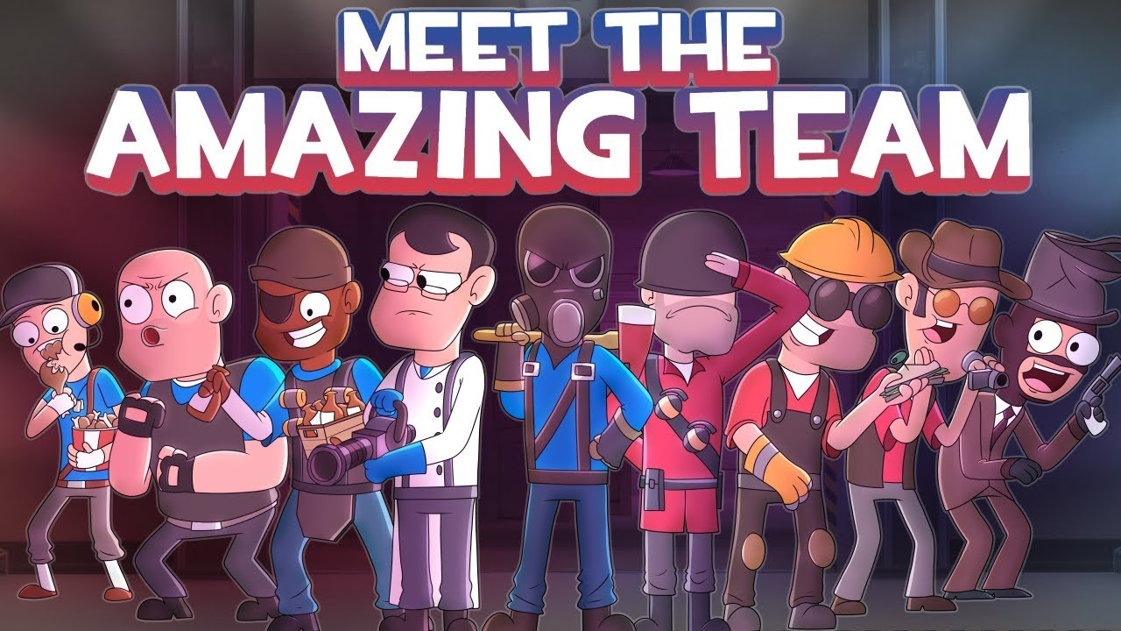
Meet the team
Mankato State University
Computer Information Technology
Stephen Ogunlana
Web developer
Mahlet Gebreegziabhar
Content Writer
Alef Feleke
Project Manager
Alef Feleke
St Cloud State University
Cybersecurity
Ku Yang
Technical Writer
Chao Chen
Javascript developer

Slide 3
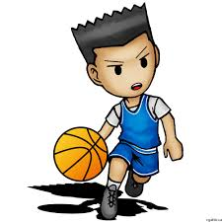
Project SCOPE
Build a platform for people to connect
Build communities
People can use the website to....
Host basketball events
Networking/find support
Pursue their passions
Availability/location
Notes:
Check for full teams
Unable to find enough people
New to the area

Slide 4

In conclusion
Community app
Ran by volunteer
It’s ran by the love of basketball not by the love of money!

